Slide 1
Alternative Scenario Development Technique
Driving Forces

Slide 2
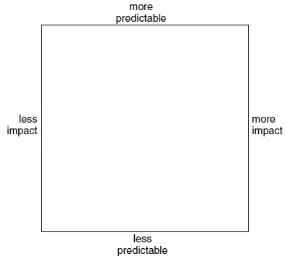
Driving Forces Outline
Identify Issue of Concern
Brainstorm anything that is related to the issue of concern
Place each issue on a impact/predictability quadrant:

Slide 3
Driving Forces Outline
Focus on issues in bottom right (High Impact / Low predictability)
Combine the issues in the bottom right into multiple inter-related groups
Attempt to Identify the ‘driving forces’ behind the groups

Slide 4
Driving Forces Outline
Pick the top 2-3 driving forces
Define each driving force by two extremes
Develop scenarios around the extremes of each driving force. How does the extreme of one combine with the extremes of another

Slide 5
Driving Forces Outline
Derive the key implications from the scenarios
Develop mitigating strategies for negative futures
Develop exploitative plans for positive futures

Slide 6
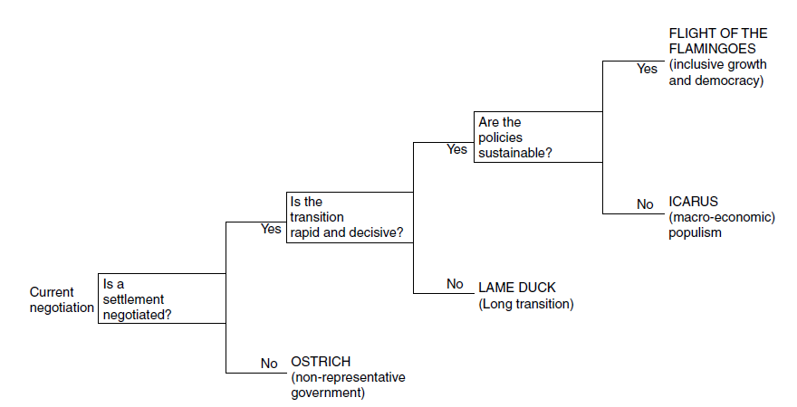
Driving Force Scenario Skeleton
Flesh out the scenarios with issues from the other quadrants
Develop storylines around the ‘skeleton’ created by the extremes of the driving forces:

Slide 7
Driving Forces Example
Concern: The survival and profitability of Fonterra
Identify some Issues that relate to this concern:
Global preference of NZ dairy products?
What is Asia’s rate of growth like?
How does the global uptake of milk products develop?
How do other dairy players in NZ develop?
NZ cow health (disease outbreaks etc)
Internal climate at Fonterra

Slide 8
Driving Forces Example
Define the High Impact / Low predictability issues
Global preference of NZ dairy products?
What is Asia’s rate of growth like?
How does the global uptake of milk products develop?
How do other dairy players in NZ develop?
NZ cow health (disease outbreaks etc)
Internal climate at Fonterra

Slide 9
Driving Forces Example
Define the High Impact / Low predictability issues
Global preference of NZ dairy products?
What is Asia’s rate of growth like?
How does the global uptake of milk products develop?
How do other dairy players in NZ develop?
NZ cow health (disease outbreaks etc)
Internal climate at Fonterra

Slide 10
Driving Forces Example
Cluster these key issues:
Global preference of NZ dairy products?
What is Asia’s rate of growth like?
How does the global uptake of milk products develop?
How do other dairy players in NZ develop?
NZ cow health (disease outbreaks etc)
Internal climate at Fonterra

Slide 11
Driving Forces Example
Establish driving forces:
What is Asia’s rate of growth like?
How does the global uptake of milk products develop?
How do other dairy players in NZ develop?
NZ cow health (disease outbreaks etc)
‘Global Development’
Major market developments
Dairy demand
‘New Zealand based Uncertainties’
Local rival strengths
Local market development

Slide 12
Driving Forces Example
Consider combinations of the extremes of the driving forces to determine storylines. (Not overall extreme scenarios necessarily)
One such outcome: ‘Flourish and Fall’:
‘Flourish and Fall’
Yes
Are global developments in NZ’s favour?
Yes
Are local developments benefitting Fonterra?
No
No

Slide 13
Driving Forces Example
Develop a storyline for each scenario:
Example: Flourish and Fall:
New Zealand suffers no major epidemics affecting cow health and Fonterra remains the primary co-operative, effectively maintaining their market share as other companies struggle to make ground.
Although local dominance is maintained, Asia begins to swallow up the global market, reducing the need for New Zealand's dairy export. Coupled with Asia’s dominance, the overall global demand for dairy lowers as the development of cheap milk substitutes picks up speed.

Slide 14
Combining Scenario Planning and Decision Analysis

Slide 15
Scenario Planning and Decision Analysis: Why?
Problems with multiple objectives can be difficult for unaided decision makers to consider evenly
Leads to incomplete/distorted solutions

Slide 16
Scenario Planning and Decision Analysis - Example
Case study example:
Newly privatised national mail company wants to develop strategies
10 year planning horizon

Slide 17
Scenario Planning and Decision Analysis - Example
Develop Scenarios using a Scenario Planning technique
Scenario 1: Dog Fight
Scenario 2: Mail Mountain

Slide 18
Scenario Planning and Decision Analysis - Example
Formulate Objectives:
Short-term Profit
Long-term Profit
Market Share
Growth
Flexibility (of the strategy)

Slide 19
Scenario Planning and Decision Analysis - Example
Develop strategies:
Status Quo
R&D
Diversify
Only feasible strategies can be considered!

Slide 20
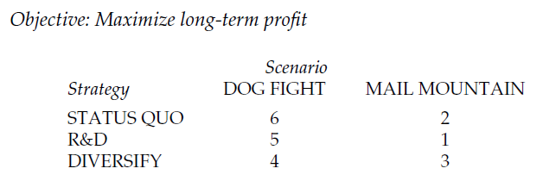
Scenario Planning and Decision Analysis - Example
a) For each objective, rank the strategy-scenario combinations:
Example)

Slide 21
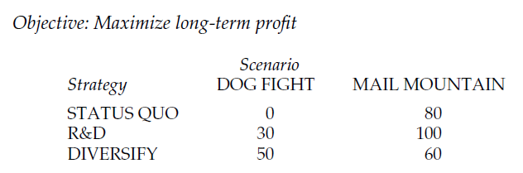
Scenario Planning and Decision Analysis - Example
b)
Allocate score of 100 to the best strategy-scenario combination & 0 to the worst.
Allocate scores between 0 and 100 for intermediate combinations

Slide 22
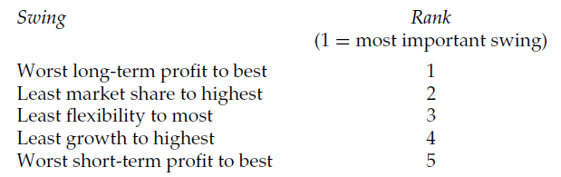
Scenario Planning and Decision Analysis - Example
a) Compare 0-100 swings in strategy-scenario combinations, for each objective.
Rank the swings in order:

Slide 23
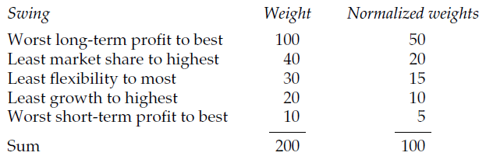
Scenario Planning and Decision Analysis - Example
b)
Assign a weight of 100 to most important swing
Compare to importance of other swings on a 0-100 scale:
Normalise these scores!

Slide 24
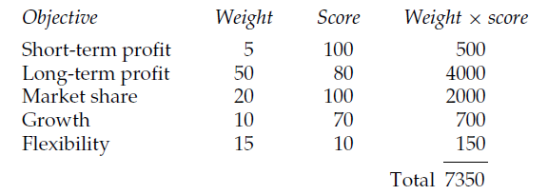
Scenario Planning and Decision Analysis - Example
For each strategy-scenario combination, multiply objective scores by objective weights
Divide total score by 100 to get an aggregate score for that combination:

Slide 25
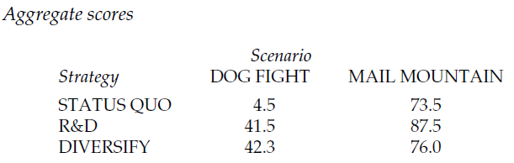
Scenario Planning and Decision Analysis - Example
Compare all the strategy-scenario scores to identify dominated strategies:

Slide 26
Conclusions on Scenario Planning
Avoids the need to deal probabilistically
Practitioner based. Not Axiom based (DA)
Storytelling via scenarios presents an easier way to make sense of uncertainty
Driving Forces method is favoured over Extreme Worlds

